Slide 1
Data Term Paper Update
Bridget Connelly
Math 442

Slide 2
Abstract
Examining the Ugandan mining industry through a network perspective
Significance: The Ugandan mining industry is under scrutiny for ties to corruption and government abuse
Status quo: Journalists have written exposes, but the sector as a whole and the relationships among companies have not been examined. Previous academic research has investigated organizational structures, but rarely in relation to potentially illicit activity
Gap: Understanding the network dynamics of the mining sector as a whole will grant a broader understanding of the influence, if any, that the organizations allied with corruption have within the network
Solution: This mapping of the mining sector will be a first look at how the mines operate within Uganda, and whether the companies accused of facilitating corruption have an outsized impact on the industry

Slide 3
Data Overview
Data from official Ministry of Energy and Mineral Development releases
Data from Uganda Ministry of Energy and Mineral Development yearly statistical abstract
Examining licensed non-prospecting miners from 2011 – 2015
There are 372 unique companies licensed
There are 1069 unique concession numbers listed
2683 entries over the 4 years
Data collected through online versions of the statistical abstract
Cleaning done to check for duplicates, make sure that companies are listed in standard forms
“Limited” often listed as “Ltd” in another year, for example
Creating multi-modal networks
Goal is to build company x company network through matrix multiplication
Data comes in the form of many networks
Company x Concession Number
Company x Address
Company x Contact Person
Company x Telephone
Company x Mineral
Company x Location

Slide 4
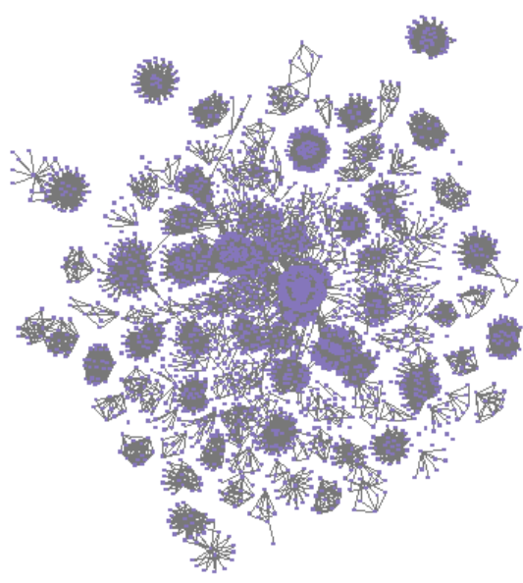
Data Description
Overall understanding of data we are working with
Network can be viewed as unique companies, companies year over year, or concession numbers. There are many levels of connections between them all
There are 381 unique organizations
Largest subcomponent of unique organizations: 119
Potential to examine changes in network structure when removing certain potentially corrupt companies. Does the overall structure of the network change? That of the components?
40 companies associated with corruption, according to the Global Witness report “Undermined,” released in June 2017
To the right is the network of companies separate by year and concession number, connected by address, phone number and contact person

Slide 5
Data Cleaning
Data not gathered with a network perspective makes cleaning especially important
Data consistency a potential problem
Reporting requirements vary from year to year
Data overlap a concern
Information not collected with network analysis in mind
Companies can keep the same concession for many years, then sell it to another company
Problem of how not to duplicate the record of a company, but maintain the information that one of their concessions was sold to another company
Additional preparation Steps:
Multiplication of networks to create large multi-modal company x company network
Potential for creating year x year analysis of network structure
Problem of keeping company ties limited to one year in the network when reporting requirements (or lack thereof) limit the overlap of types of data between years

Slide 6
Methodology
Understand data piece by piece
Company attributes include
Concession number
Postal address
Contact name
Mine location
Mine licensed
Network-level measures
Density in organization x attribute networks shows generally how many companies will have similar attributes
Average degree will be skewed towards the dyads, but will give a good comparison for corrupt organization networks
Centrality measures
Which companies or attributes are coming out as the most important in the folded networks
Using outside data sources, research why these companies or attributes are being brought forward by the measures

Slide 7
Analysis: Transfer of Addresses
How do companies use reported postal addresses?
292 addresses
372 organizations
457 links
Density of Org x Address Network: 0.024095
Mostly dyads (165 / 372) ➔ companies have a constant address
Some larger components (15 / 372) ➔ companies list same address, or move addresses
Largest component = 162 organizations
Density of Org x Address x Org Network: 0.05523365
Mostly isolates (183 / 372) ➔ companies listed a unique address
Some larger components (6 / 372) ➔ multiple companies listed the same address
Largest component = 109 organizations

Slide 8
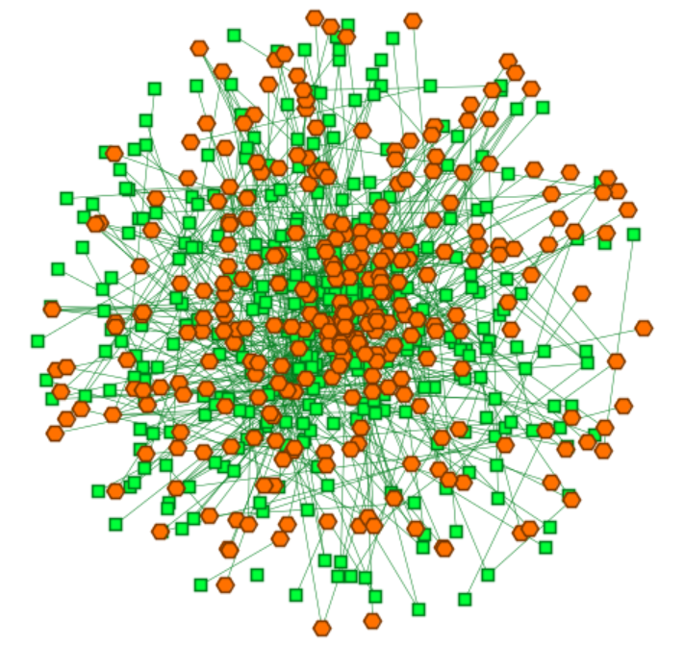
Analysis: Transfer of Addresses (cont.)
How do companies use reported postal addresses?
Top organization in multiple measures appeared in Global Witness Report “Undermined,” which documented potential corruption in Ugandan mining
Gold Hunters Limited
Registered in Uganda in 2011
Little information on former or current ownership, shareholders, employees
Further analysis needed to figure why this should be so highly ranked
At left, the org x address network

Slide 9
Analysis: Next Steps
Research never stops…
Run the same type of analysis for concession number trading
Run the same type of analysis for contact names
Not likely to have same scope of results – fewer years required contact names
Examine the proportion of mining licenses owned by individual people
Examine the network of company identifiers, i.e. address, contact person, phone number, against the type of mineral companies are licensed to take, or the area in which they can conduct business
Will require data cleaning of its own, as companies are often allowed to search for more than one mineral, or may be located in many locations or broad regions
Remove Global Witness-based potentially corrupt companies and remove to asses network impact
Choose one of the organizations, concessions, addresses, or people that comes out of the analysis to build a story

